Slide 1
Final Project
Cryptocurrencies
Yay or Nay?
CIS 509 Group 18
Group Members: Anurag Bhattacharjee, Jing Hao, Yash Jain, Dinesh Koonamakkal, Yugantika

Slide 2
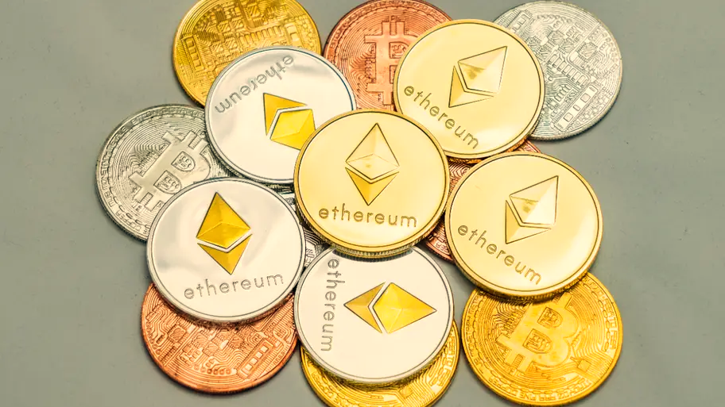
Context
1. Project Overview
Topic Modeling
3. Sentiment Analysis
4. Overall Analysis
5. Key Insight and Challenges

Slide 3

1
Overview
Background and Project objective
Cryptocurrency, an innovation which is-
Helping businesses & people across the world
Fast, Safe & freedom to Transact Untraceable (pseudo-anonymous transactions)
Transparent & Neutral
Decentralized in Nature
Low Inflation & Collapse Risk
In our Project…..
We are doing a sentiment analysis for major cryptocurrencies- Bitcoin, Dogecoin, Litecoin, Ethereum, Cardano (ADA) for the time frame of before & after Covid pandemic, & try to investigate the positioning of cryptocurrencies during the entire cycle.
This study provides a roadmap/pointers for the people who are interested to invest in crypto & looking out for a research study to understand the pattern of the same for their future investments

Slide 4
1
Overview
Execution Approach
Step1
Step2
Subreddits selection
Reddit Data Extraction
Selected Five subreddits :
r/Bitcoin, r/Dogecoin, r/Litecoin, r/Ethereum, r/Cardano
Collected data from 2018 to 2022.
Before Covid: Jan. 2018- Dec.2019; After Covid: Jan. 2020-Now
number of comments | 10212
number of unique words | 17430
total number of words in the corpus | 231901
Step5
Step4
Step3
Insights
Sentiment analysis
Topic Modeling
Provided key insights based on our analysis
Used VADER to analyze reddit comments to interpret emotions for cryptocurrencies
Used LDA to extract topics from given data

Slide 5
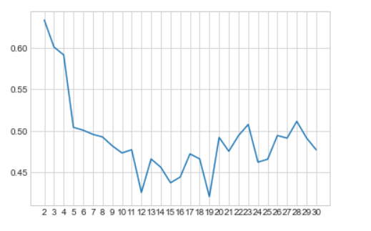
2
Topic Modeling
Coherence Plot
Coherence Analysis
Best K value = 3, λ = 0.03
High Coherence measure
We have tried K=3,5,8, but when K =3, it has no overlapping, and it is more interpretable than others(i.e. clusters has less noise)

Slide 6
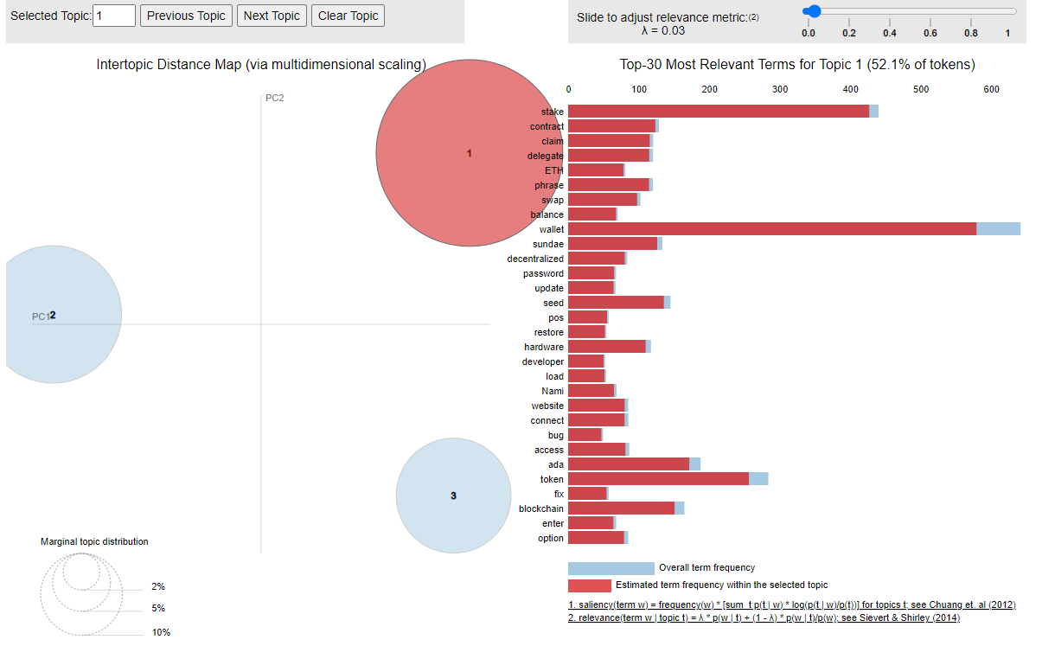
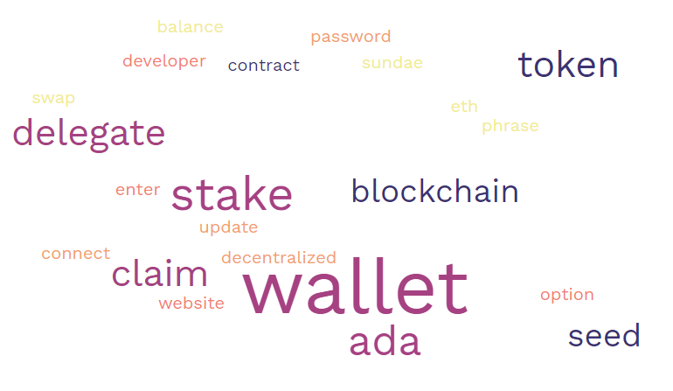
2
Topic Modeling
Topic Selection: Wallets
Topic 1: Wallets
This topic discusses the usage and possibilities of decentralized exchange ecosystem that is based on the blockchain that uses browser based wallets to send and store cryptocurrencies, mint tokens validated by POS mechanism
“It says this taxable event only occurs when the token leaves the users wallet I thought the benefit of cardano is that even when staking the tokens actually never leave your wallet?”

Slide 7
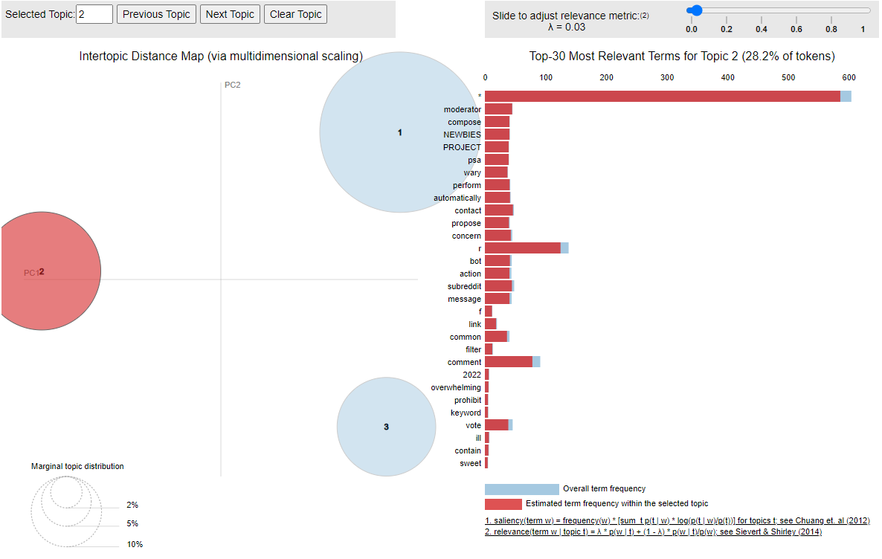
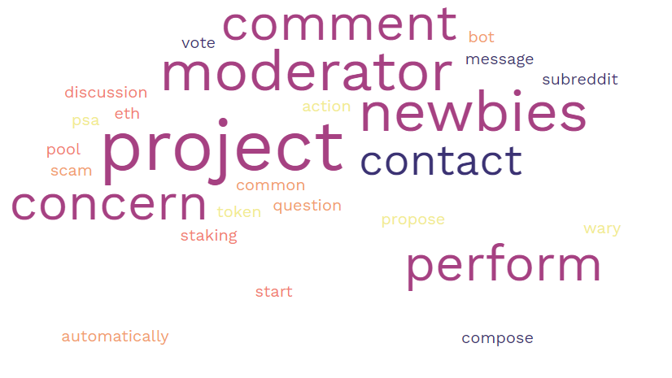
2
Topic Modeling
Topic Selection: Investment
Topic 2: Investment
This topic seems to be dealing with moderator posts directed towards newbies in the crypto space, asking them to be wary of scams, it also has comments where the bots are removing comments about prices and which look like scams. This cluster also covers the posts where newbies are seeking guidance.
“Caution: Newbie Question! When are ETH gas fees at the Lowest? Is there a day and a time?”
“I think there are still a lot of people joining Dogecoin because some newbies who are new to cryptocurrency will hold some Dogecoin because I did it when I was first in contact”

Slide 8
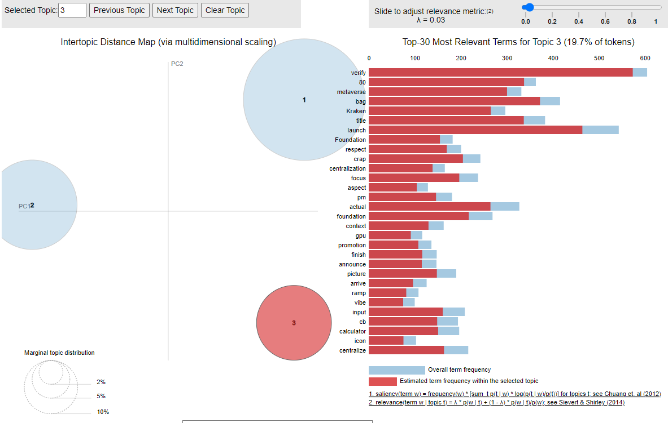
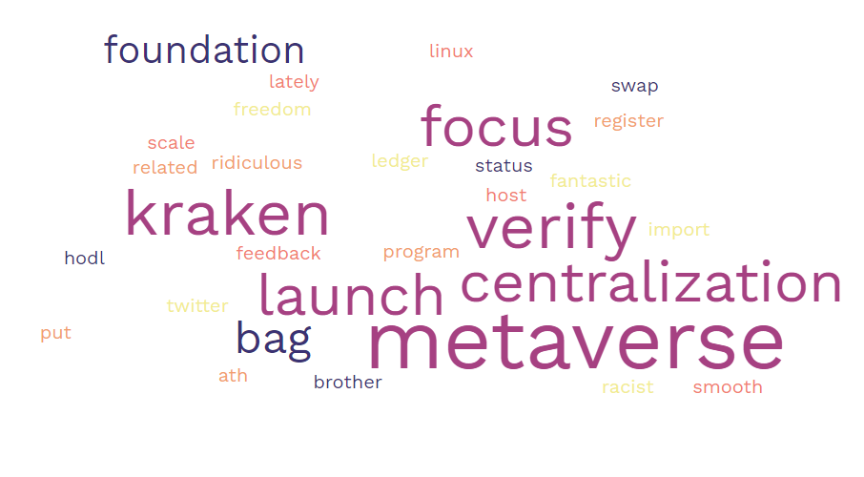
2
Topic Modeling
Topic Selection: Metaverse Cryptocurrencies
Topic 3: Metaverse Cryptocurrencies
This topic discusses the possibilities of crypto transactions in the Metaverse ecosystem that require high GPU performance and how the arrival of Kraken exchange system has influenced the dynamics of it.
“You can check on any blockchain explorer to see if your transfer has completed. I think your issue is not that the transfer time is slow but rather the crediting system run by Kraken may not be as quick as you like”.

Slide 9
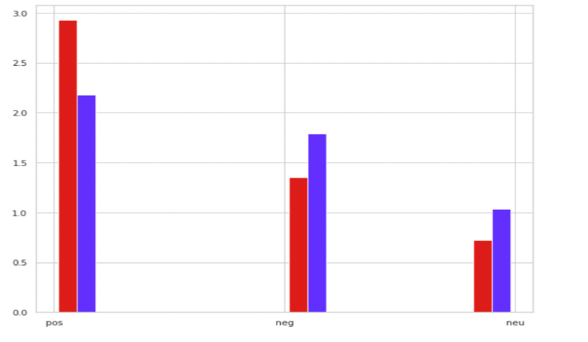
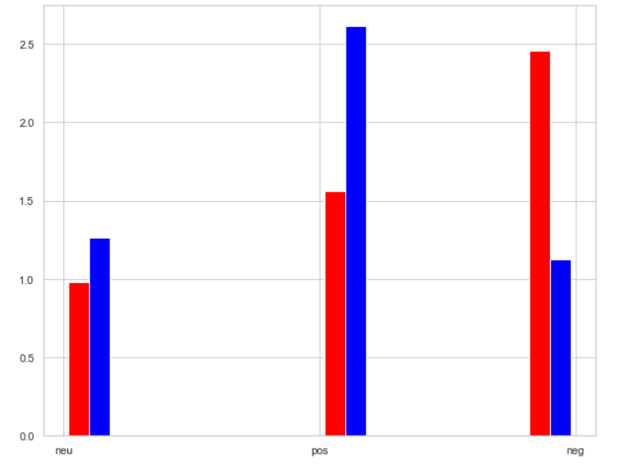
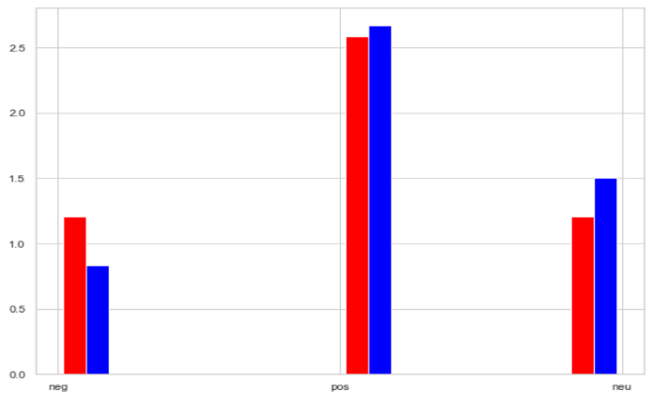
3
Sentiment Analysis
Sentiment: r/Bitcoin
Cryptocurrencies
Topic 1: Wallet
Topic 2 : Investment
Topic 3: metaverse cryptocurrencies
Bitcoin
 | Positive | Neutral | Negative
Before | 58.6% | 14.4% | 27.0%
After | 43.5% | 20.7% | 35.8%
 | Positive | Neutral | Negative
Before | 31.2% | 19.7% | 49.1%
After | 52.3% | 25.2% | 22.5%
 | Positive | Neutral | Negative
Before | 51.7% | 24.1% | 24.1%
After | 53.3% | 30.0% | 16.7%
Ethereum
Litecoin
Dogecoin
Cardano
Good
Neutral
Bad
Good
Neutral
Bad
Good
Neutral
Bad

Slide 10
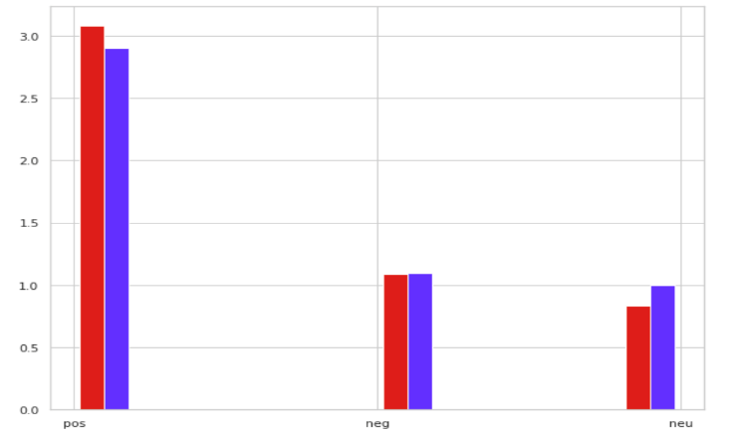
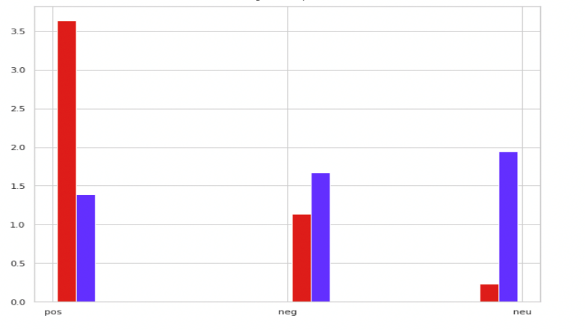
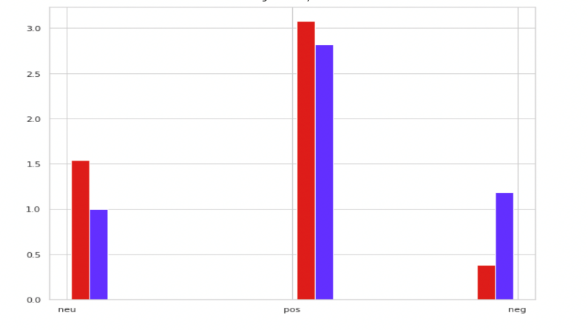
3
Sentiment Analysis
Sentiment: r/Ethereum
Cryptocurrencies
Topic 1: Wallet
Topic 2 : Investment
Topic 3: metaverse cryptocurrencies
Bitcoin
 | Positive | Neutral | Negative
Before | 61.6% | 16.7% | 21.7%
After | 58.1% | 21.9% | 20.0%
 | Positive | Neutral | Negative
Before | 72.7% | 4.5% | 22.7%
After | 38.9% | 33.3% | 27.8%
 | Positive | Neutral | Negative
Before | 61.5% | 7.7% | 30.8%
After | 56.4% | 23.6% | 20.0%
Ethereum
Litecoin
Dogecoin
Cardano
Good
Neutral
Bad
Good
Neutral
Bad
Good
Neutral
Bad

Slide 11
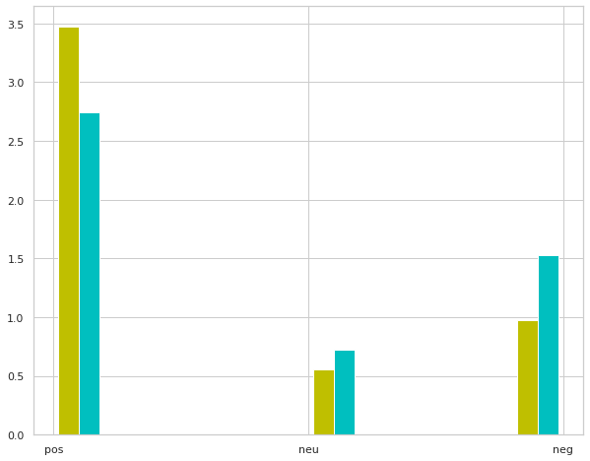
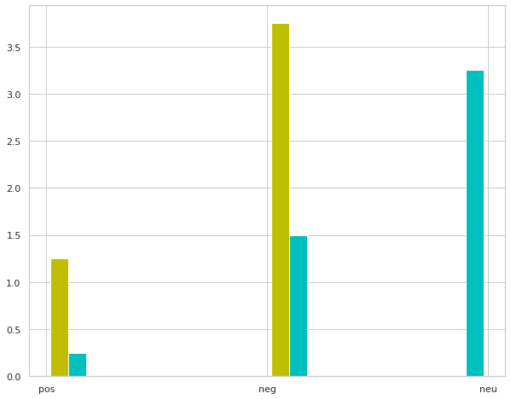
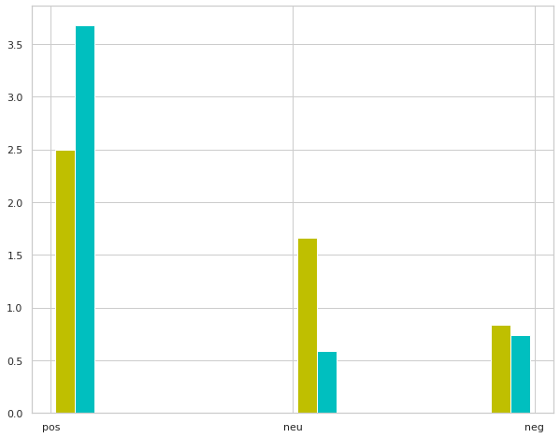
3
Sentiment Analysis
Sentiment: r/Litecoin
Cryptocurrencies
Topic 1: Wallet
Topic 2 : Investment
Topic 3: metaverse cryptocurrencies
Bitcoin
 | Positive | Neutral | Negative
Before | 69.4% | 19.4% | 11.1%
After | 54.8% | 30.6% | 14.5%
 | Positive | Neutral | Negative
Before | 75.0% | 0% | 25.0%
After | 65.0% | 30.0% | 5.0%
 | Positive | Neutral | Negative
Before | 50.0% | 33.3% | 16.7%
After | 73.5% | 14.7% | 11.8%
Ethereum
Litecoin
Dogecoin
Cardano
Good
Neutral
Bad
Good
Neutral
Bad
Good
Neutral
Bad

Slide 12
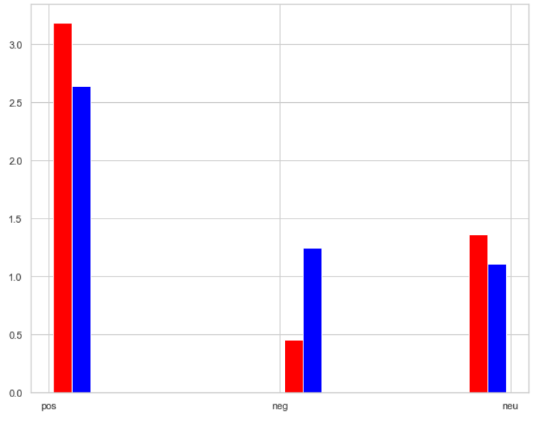
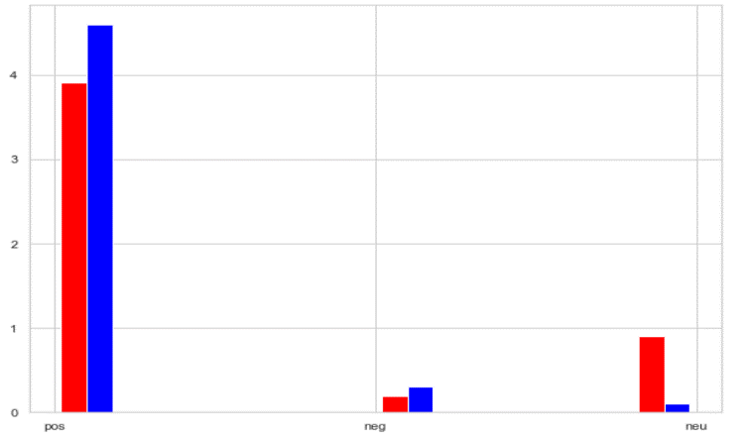
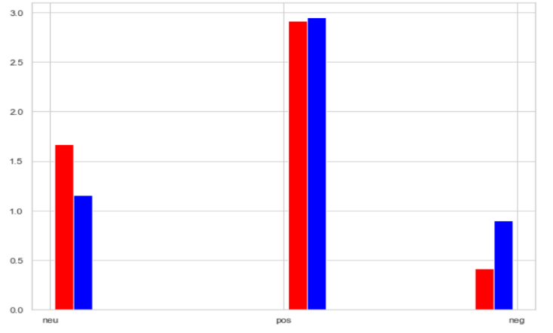
3
Sentiment Analysis
Sentiment: r/Dogecoin
Cryptocurrencies
Topic 1: Wallet
Topic 2 : Investment
Topic 3: metaverse cryptocurrencies
Bitcoin
 | Positive | Neutral | Negative
Before | 63.6% | 27.3% | 9.1%
After | 52.8% | 22.2% | 25.0%
 | Positive | Neutral | Negative
Before | 78.1% | 18.1% | 3.8%
After | 91.8% | 2.0% | 6.1%
 | Positive | Neutral | Negative
Before | 58.3% | 33.3% | 8.3%
After | 59.0% | 23.1% | 17.9%
Ethereum
Litecoin
Dogecoin
Cardano
Good
Neutral
Bad
Good
Neutral
Bad
Good
Neutral
Bad

Slide 13
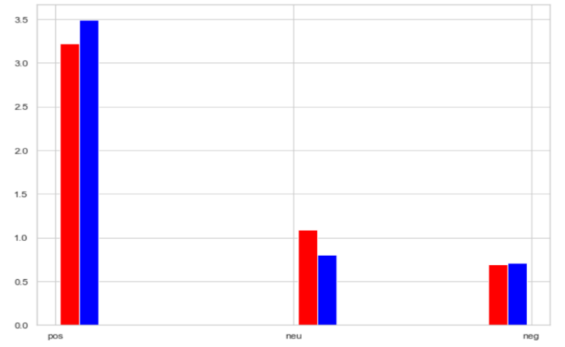
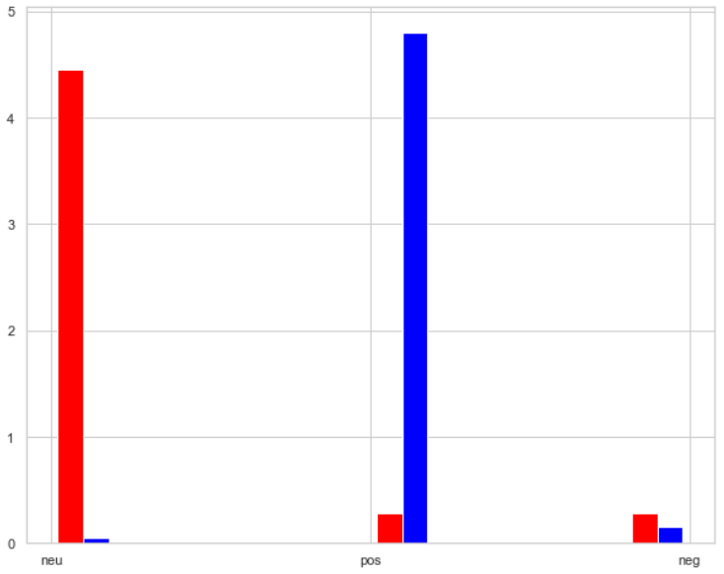
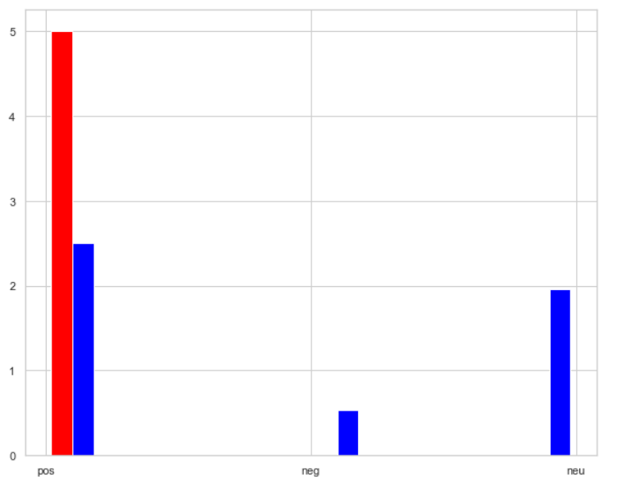
3
Sentiment Analysis
Sentiment: r/Cardano
Cryptocurrencies
Topic 1: Wallet
Topic 2 : Investment
Topic 3: metaverse cryptocurrencies
Bitcoin
 | Positive | Neutral | Negative
Before | 64.4% | 21.8% | 13.8%
After | 69.8% | 16.0% | 14.2%
 | Positive | Neutral | Negative
Before | 5.6% | 88.9% | 5.6%
After | 95.9% | 1.0% | 3.1%
 | Positive | Neutral | Negative
Before | 100.0% | 0% | 0%
After | 50.0% | 39.3% | 10.7%
Ethereum
Litecoin
Dogecoin
Cardano
Good
Neutral
Bad
Good
Neutral
Bad
Good
Neutral
Bad

Slide 14
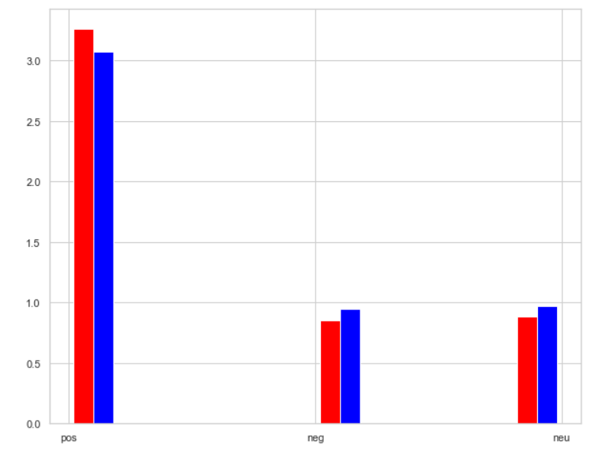
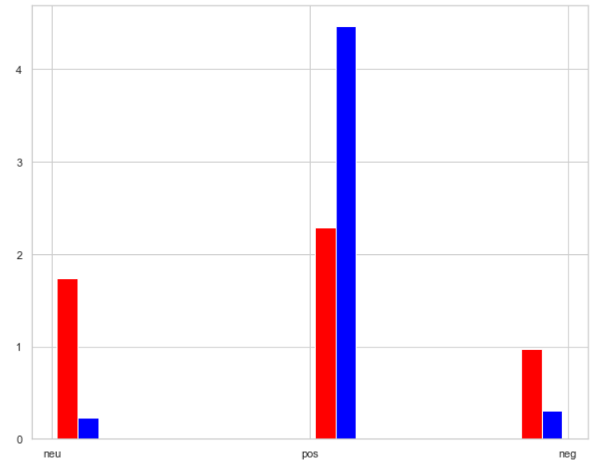
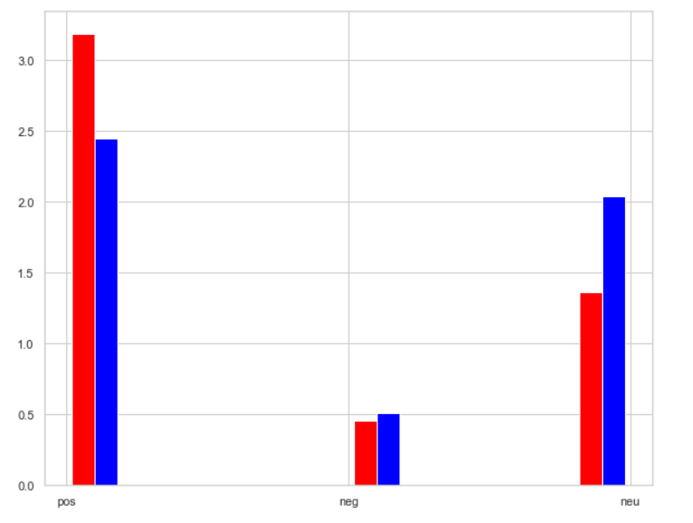
4
Overall Analysis
Overall Analysis
Wallet
Investment
metaverse cryptocurrencies
 | Positive | Neutral | Negative
Before | 65.2% | 17.7% | 17.1%
After | 61.5% | 19.5% | 19.0%
 | Positive | Neutral | Negative
Before | 45.8% | 34.7% | 19.4%
After | 89.3% | 4.6% | 6.1%
 | Positive | Neutral | Negative
Before | 63.6% | 27.3% | 9.1%
After | 49.0% | 40.8% | 10.2%
Overall
Analysis for
Three
Topics
Emotions
Good
Neutral
Bad
Good
Neutral
Bad
Good
Neutral
Bad
Keywords
Positive: great, join, interest
Positive: sure, efficient, great
Positive: allow, motivated, definitely
Negative: failures, fears, weakening
Negative: unhappy, risks, fraud, not
Negative: attacker

Slide 15

5
Insights
Key Insights and Challenges
Challenges
Wallets have been necessary for any cryptocurrency investor be it pre or post covid.
For POS mechanisms to work wallets must be used for frequent transaction.
Unstructured data
Irrelevant (noisy) data
Huge volume data
Dip in crypto market during covid times led to increased flurry of investments over post covid times, this substantiates the positive sentiment around “Investment” in our analysis.
Newbies who are new to cryptocurrency investment should hold Dogecoin as it has shown high positive sentiment in the recent time.
The dip in the global markets did open up avenues for investment into crypto. Metaverse being unexplored territory could not ride this wave. The negative sentiment towards Metaverse cryptocurrencies has increased considerably post covid.
Since, Metaverse is still in its nascent stages, we believe Metaverse cryptocurrencies would gain more positive sentiment among the general mass in the near future.

Slide 16
Thank you!

